Slide 1
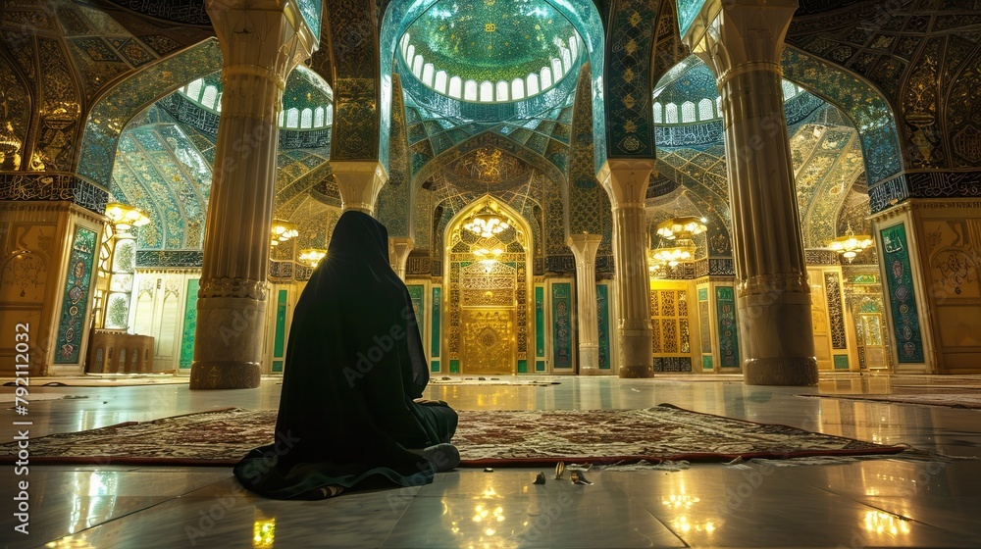
Welcome to our Presentation

Slide 2
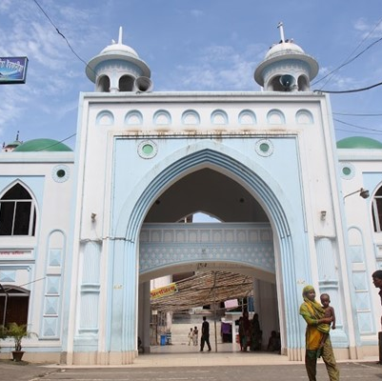
Mazar Destruction: A Threat to Bangladesh's Folklore and Heritage
An Exploration of Cultural Impact

Slide 3
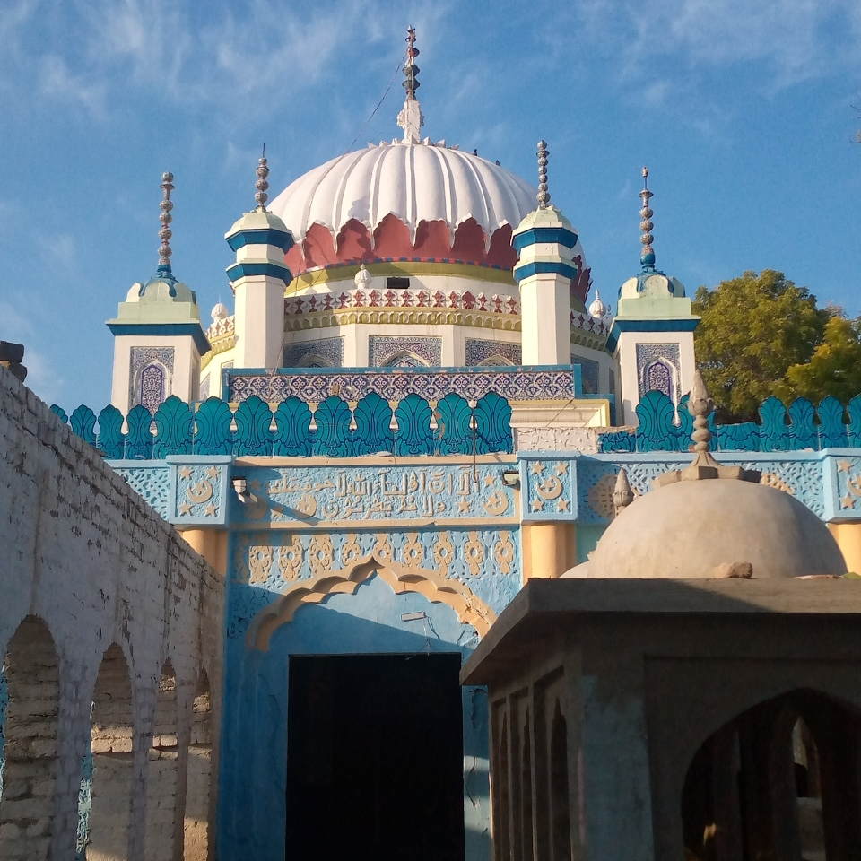
01. Mazar Destruction in Bangladesh
In recent months, Bangladesh is facing a concerning trend of mazar destruction, causing concern among communities and cultural advocates. These shrines, dedicated to Sufi saints, are vital to the country's folklore and heritage. The destruction is often driven by political desires, aiming to reshape the cultural landscape. The loss of these sacred spaces threatens community identity and local traditions, highlighting the urgent need to address this issue and preserve the cultural heritage.
This presentation aims to raise awareness about the recent destruction of mazars in Bangladesh, highlighting their historical and spiritual significance within local communities.

Slide 4
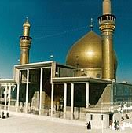
02. Historical Significance of Mazars
Historical Roots
Commemorate Sufi saints who spread Islamic thought in Bangladesh.
Reflect a blend of Islamic and local cultural elements.
Preservation of Oral Traditions
Serve as custodians of stories and teachings passed down through generations.
Central to cultural practices, festivals, and rituals.

Slide 5

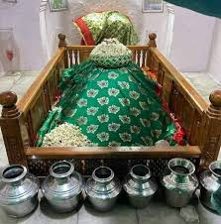
03. Factors Leading to the Destruction of Mazars
Urbanization and Development Pressures
Rapid urban expansion often leads to the encroachment and demolition of mazars for infrastructure projects.
Increased demand for land for housing and commercial development threatens the preservation of these sites.
Political and Social Conflicts
Tensions between different religious and cultural groups can result in targeted attacks on mazars.
Political agendas may exploit these conflicts, leading to the destruction of sites viewed as symbols of opposition.

Slide 6
—Monirul Islam, Officer in Charge
04. Local Administration say about Vandalism
“I have just joined the police station. We were not able to take any action quickly in the case of shrine vandalism.”

Slide 7
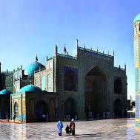
05. How Mazars Destruction Affects
Loss of Oral Traditions and Cultural Narratives
Destruction of mazars leads to the erasure of stories and legends associated with the saints, diminishing the richness of local folklore.
The absence of these sites disrupts the transmission of cultural narratives, as they are often shared during rituals and community gatherings.
Impact on Community Identity and Cohesion
The loss of these cultural landmarks weakens social ties, as communities lose shared spaces for worship and cultural expression.
This erosion of cultural heritage can result in diminished pride and cohesion within communities, impacting their overall social fabric.

Slide 8
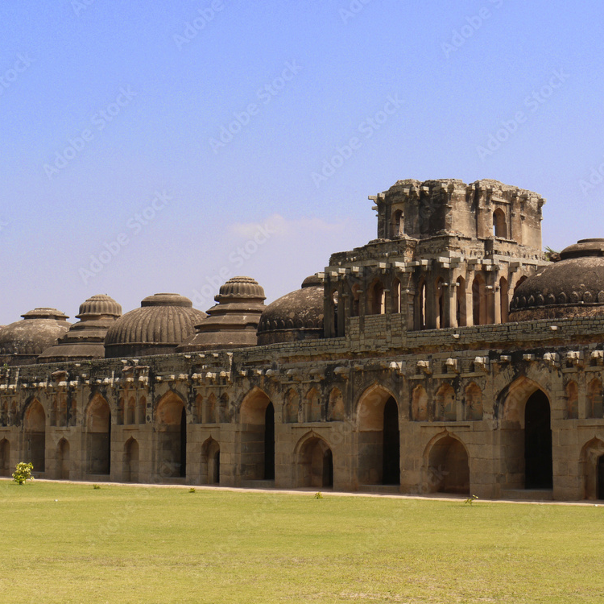
06. Role of Government, NGOs, and Local Communities in preventing Mazar Destruction
Government Involvement
Local and national governments are beginning to recognize the importance of mazars as cultural heritage sites and are implementing policies for their protection.
Community Engagement
Local communities play a crucial role by organizing events and activities that celebrate the cultural significance of mazars, fostering a sense of ownership and responsibility towards their preservation.

Slide 9
07. Conclusion
The destruction of mazar (shrines) in Bangladesh poses a significant threat to the country's rich folklore and heritage. The loss of these cultural and historical sites erases the nation's collective memory, identity, and traditional practices. It is essential to preserve and protect these sacred places to safeguard Bangladesh's cultural legacy.

